Slide 1
Non Linear Regression
Joshua Lok
Stephen Phillips
Sadia Perveen

Slide 2
Non-Linear Regression Overview
Form of regression analysis in which observational data are modeled by a function that is a non-linear model parameters based on one or more independent variables.
Non-Linear regression adds extra independent variables if residual plot shows curvature
Transformation is sometimes done to create linearity but can complicate the interpretation of the coefficients
Typical Situation
Include Biological process, Chemical reaction, Engineering and Physics situation
Common libraries and packages that are used:
R
nls, nlme, brms, and mgcv
Python
Scikit-learn, statsmodels, SciPy, TensorFlow and PyTorch

Slide 3
Non-Linear vs Linear Regression
Key Differences:
Linear regression relates two variables with a straight line (y=mx+b). Nonlinear regression relates the two variables in a non-linear curved relationship.
Linear regression requires linear parameters while nonlinear regression does not.
Example of linear regression: Predicting house prices based on area, predicting sales based on advertising spend.
Example of non-linear regression: Modeling population growth, predicting enzyme kinetics.

Slide 4
Examples of Non-Linear Regression
Supervised Learning
k-Nearest Neighbors(KNN)
Support Vector Machines(SVMs)
Decision Trees
Gradient Boosting Machines
Multivariate Adaptive Regression Splines
Unsupervised Learning
Autoencoders
Deep Belief Networks(DBNs)
*Note: Neural Networks can be Both

Slide 5
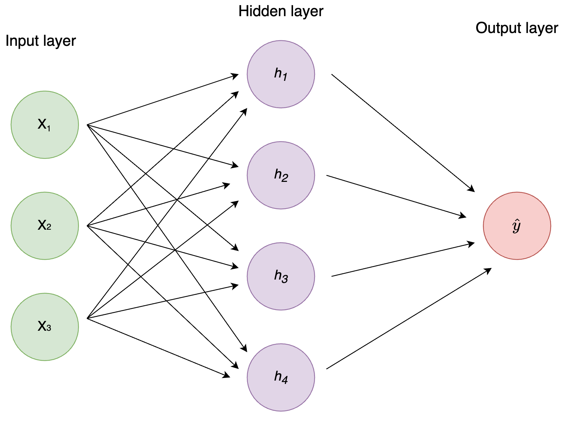
Neural Network
What are they?
Computational models inspired by the human brain’s structure to recognize patterns in complex data.
Consist of layers of nodes or neurons that processes input data and passes outputs to subsequent layers
Learns by adjusting weights and biases of connection
Used in NLP and Predictive Analytics
Types of Neural Networks includes:
Feedforward Neural Networks (FNN)
Convolutional Neural Networks (CNN)
Recurrent Neural Network (RNN)

Slide 6
Neural Network
Structure/Components
Neurons(Nodes): Base processing units that inputs, process, and outputs information
Layers: Organizes neurons in a structured way to process data
Parameters and Adjustments
Weights and Biases: Parameters that are tuned during training to help network become more accurate
Learning Rate: Helps determines how much parameters change during each interaction of training
Learning Process
Activation Function: Introduces non-linearity to help learn complex patterns
Loss Function: Measures how well the network is performing and provides target improvement
Optimizer: Helps the network adjust its weights and bias to minimize errors
Backpropagation: Method used to apply the previous adjustments based on the networks performance
Training Dynamics
Epochs: Represents the number of times the entire dataset is passed through the network for learning

Slide 7
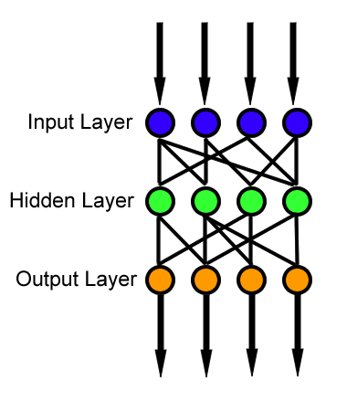
Feedforward Neural Networks (FNN)
Specific Traits
One of the simplest types of neural networks
Information moves in only a forward direction
No cycles or loops within the network
Learns through backpropagation
Basic structure is 3 types of layers
Input, Hidden, and output
Does not Retain any memory elements
Highly Scalable and Efficient

Slide 8
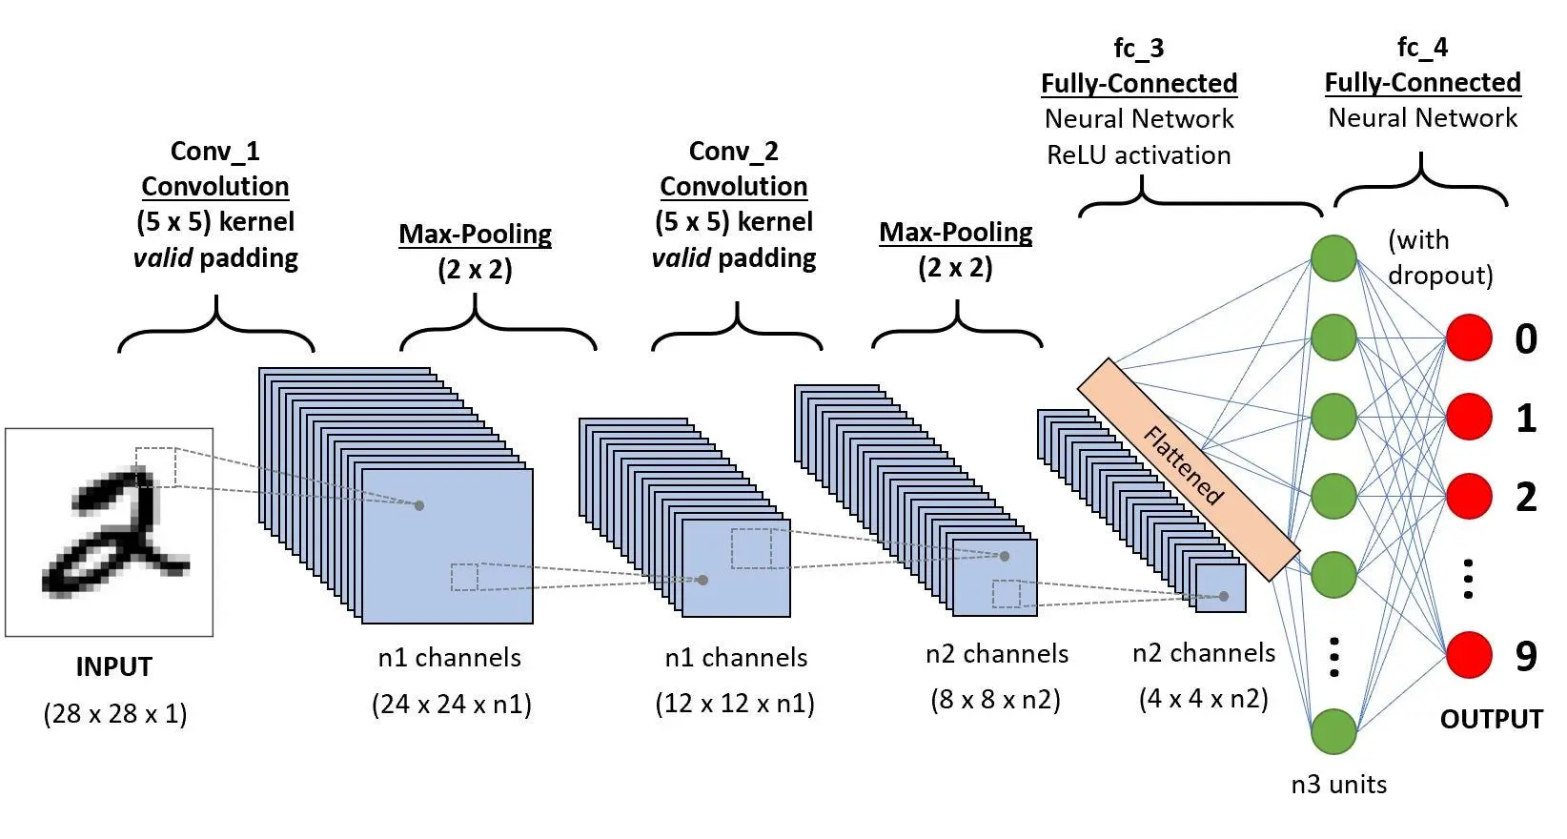
Convolutional Neural Networks (CNN)
CNN Architecture consists of:
Input Layer, Convolutional Layer, Max Pooling Layer, Dense Layer, Out Layer
Localized Pattern Recognition allows them to recognize patterns with extreme variability that are localized to specific regions
Parameter Sharing
Allows for this class to be efficient and scalable due to reusing same parameters
Translation Invariance
CNN are able to recognize objects in an image regardless of where they are located within the image
Pooling Layers to reduce spatial dimensions of the input volume
Automatic Feature Engineering
Learn the most relevant features during training

Slide 9
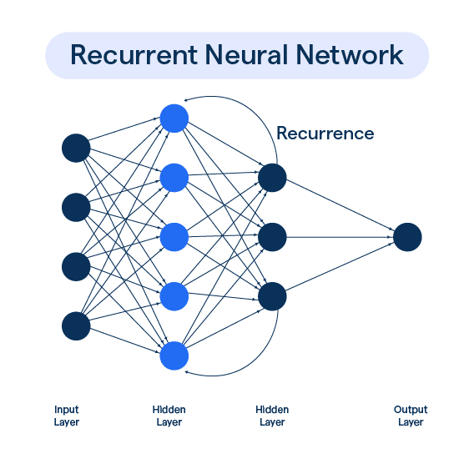
Recurrent Neural Network (RNN)
Specific Traits
Memory Capability
Able to maintain information in memory over time with the internal loop
Sequential Data Processing
Allows the model to maintain sense of order, useful for language modeling where order matters
Shared Parameters Across Time
Similar to CNN it also shares parameters
Backpropagation Through Time (BPTT)
Process that involves unfolding the network through time then backpropagating on error
Bidirectional Processing for enhancing sequence context
Flexible Architecture that includes Long Short-Term Memory(LTSM) and Gated Recurrent Units(GRU)
Designed to solve the vanishing gradient problem common in RNN

Slide 10
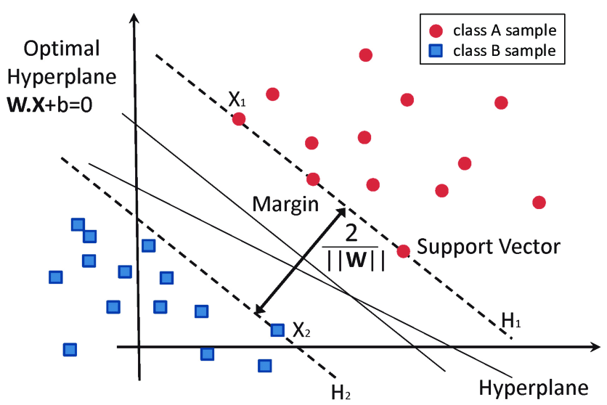
Support Vector Machines (SVM)
Originally a linear model, advancements have generalized it to nonlinear problems
An SVM model is comprised of: data, support vectors and a hyperplane
Hyperplane: A boundary that separates a space into two parts or a subspace that is one less dimension than ambient space
Support Vector: The data points that are closest to the hyperplane
Used for classification problems and regression problems
Optimization based around maximizing margins around the hyperplane or the amount of separation between the classes
Unlike most models, the model is created by analyzing the outliers of the classes, rather than the majority of data points
For data that is not cleanly separatable, “soft margins” can be used, which will allow some data points between the margins on each side of the hyperplane

Slide 11
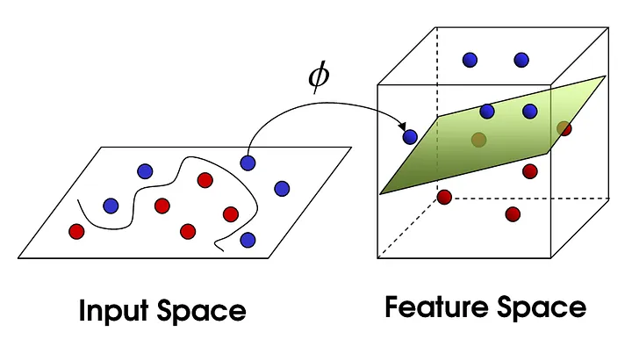
Kernel Trick
Problem: SVMs are originally only able to provide linear decision boundaries, but real world problems are often not able to be separated linearly
Solution: A kernel trick allows for an algorithm to find a hyperplane in a feature space that is transformed to be linear, even if it is originally a non-linear original space
A kernel function is one that takes vectors from the original dimensions as inputs and returns the dot product of the vectors in the feature space
The advantage of the kernel function is that because of how it operates, it doesn’t require any computations for the coordinates of the data in the higher dimensional space
There are a variety of kernel functions to map different types of data which include linear, gaussian, polynomial, and sigmoid

Slide 12
Advantages:
Effective in high-dimensional spaces
Works well in small datasets, as only a few support vectors are needed
High generalization Performance
Versatility in classification and regression problems
Modularity in model to avoid overfitting
Disadvantages:
Not effective for large datasets
Overlapping target classes can heavily reduce performance
Requires computationally expensive optimization problems
Limited to two-class problems

Slide 13
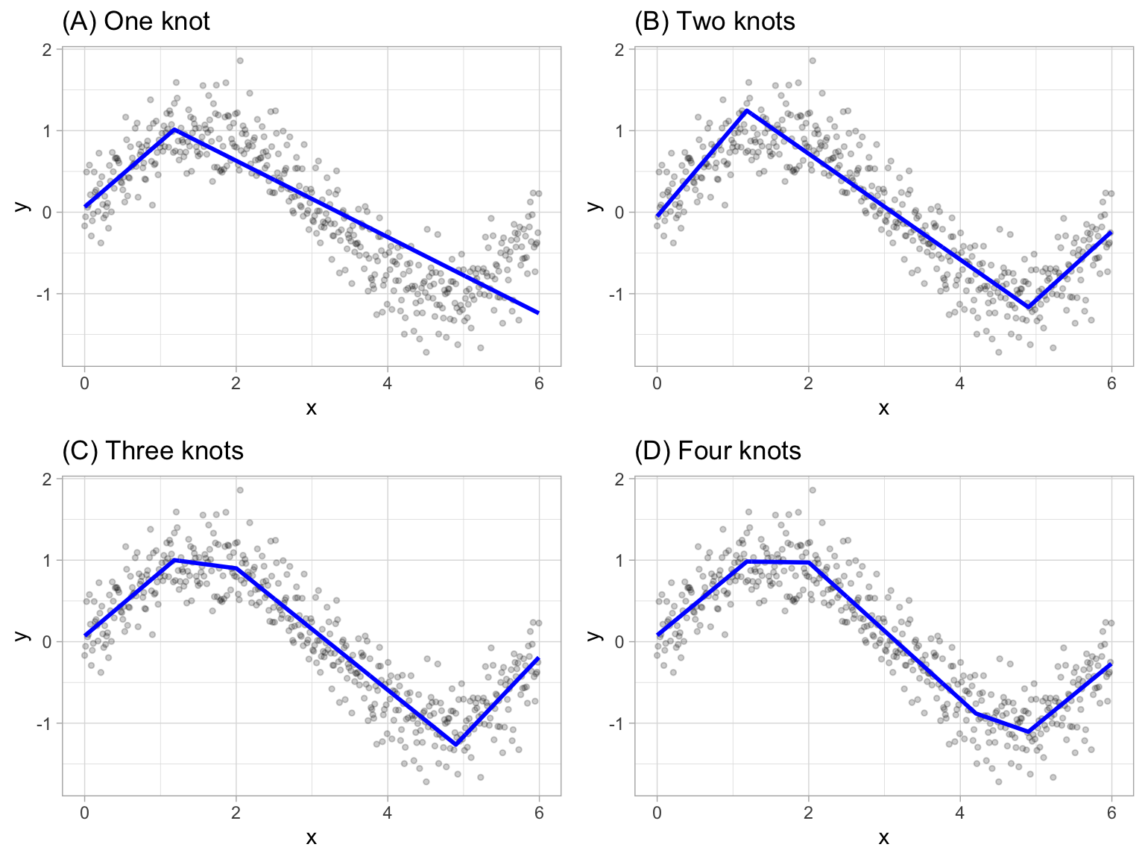
Multivariate Adaptive Regression Splines
Goals: Create a piecewise linear model so that the relationship between the predictor and response can be different for different ranges of the predictors
“Cut points” are created, and between each of them, a different OLS line is fit in such a way that there is one continuous function
For MARS models, each datapoint for each predictor is evaluated as a potential cut point, and a regression model is fit. The predictor/ cut point pair with the smallest sum of square residuals is fit. This process is repeated for subsequent cutoff points until a defined stopping point is reached
The common stopping point for the model is an R² increase of less than .001

Slide 14
K-Nearest Neighbors
KNN approach simply predicts a new sample using the K-closest samples from the training set.
It works on the principle of similarity, where similar data points are grouped together.
The algorithm stores all available data points along with their respective class labels or target values during the training phase.
For prediction, in classification tasks, KNN identifies the k nearest neighbors to a new data point based on a chosen distance metric, assigning the majority class among these neighbors to the new point.
In regression tasks, KNN calculates the average (or weighted average) of the target values of the k nearest neighbors and assigns this value to the new data point.
When creating a model, K (number of Neighbors) is the hyperparameter that must be tuned.
A small K (1 to 3 neighbors) might lead to too much noise
A large K may lead to overly smoothing the predictions

Slide 15
Advantages:
Simple to implement
Can be used for both classification and regression
No real parameters to tune besides K
Non-parametric algorithm
Can handle multiple classes for classification
Disadvantages:
Computationally expensive for large datasets
Doesn’t work well for high dimensionality
Sensitive to noisy data

Slide 16
References
MARS - https://www.youtube.com/watch?v=CMZ4I09PL_I
SVM - https://www.youtube.com/watch?v=_PwhiWxHK8o
KNN- https://learn.g2.com/k-nearest-neighbor
Kernel Trick- https://towardsdatascience.com/the-kernel-trick-c98cdbcaeb3f#:~:text=The%20%E2%80%9Ctrick%E2%80%9D%20is%20that%20kernel,the%20data%20by%20these%20transformed
Non-Linear Regression - http://www.cnachtsheim-text.csom.umn.edu/kut86916_ch13.pdf
Non-Linear Regression - https://www.ibm.com/docs/en/spss-statistics/29.0.0?topic=regression-nonlinear
Neural Network - https://www.sciencedirect.com/topics/neuroscience/neural-network

Slide 17
Questions?

